Slide 1
Implement Microsoft identity (Part 2)
Implement Authentication
Implement Authorization

Slide 2
Implement Authentication

Slide 3
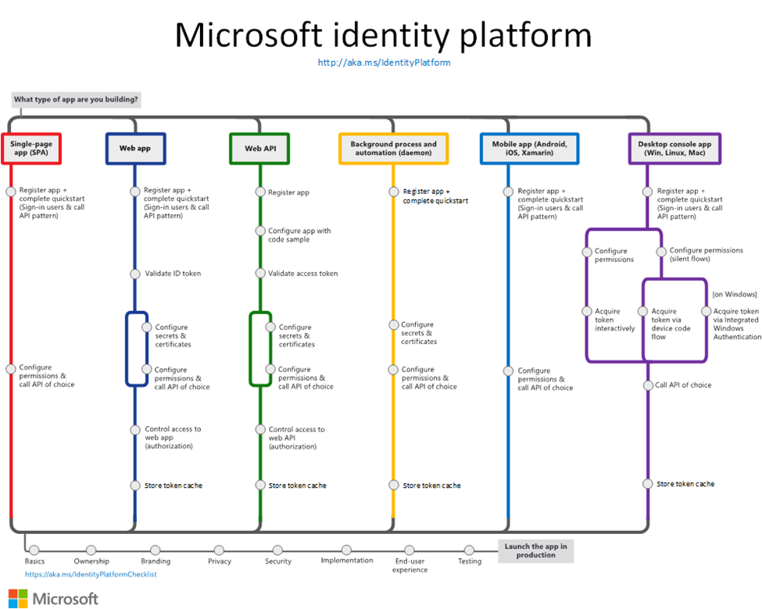
Authentication flows and application scenarios
Authentication categories
Protected resources vs. client applications
With users or without users
Single-page, public client, and confidential client applications
Sign-in audience
Supported OAuth 2.0 flows
Supported platforms
Notes:
The Microsoft Identity platform (v. 2.0) endpoint supports authentication for a variety of modern app architectures, all of them based on industry-standard protocols OAuth 2.0 or OpenID Connect.

Slide 4
Microsoft Authentication Library (MSAL)
Microsoft Authentication Library (MSAL) enables developers to acquire tokens from the Microsoft identity platform endpoint in order to access secured Web APIs.
Application types and scenarios.
Languages and frameworks.

Slide 5
Security tokens for Microsoft identities
ID token
An ID token is a security token that allows the client to verify the identity of the user.
Access tokens
Access tokens enable clients to securely call APIs protected by Azure AD. Access tokens are sometimes referred to as “User+App” or "App-Only"

Slide 6
Demo
Implementing Authentication
Notes:
Demo Resources Found Here: https://microsoft.sharepoint.com/:w:/t/MOCtoBaselineevents/EbgnPm8Toz1FgNelsQcnlSEBD0hc9hjlfmRXf2QXgfPMNQ?e=r4Kk1Z

Slide 7
Implement Authorization

Slide 8
Overview of authorization model
Applications that integrate with Microsoft identity platform follow an authorization model that gives users and administrators control over how data can be accessed.
OAuth 2.0 authorization code flow
Scopes and permissions
Delegated vs. application permissions
Effective permissions
Requesting consent for an entire tenant
Admin-restricted permissions
Notes:
OAuth 2.0 is a method through which a third-party app can access web-hosted resources on behalf of a user.
By defining permissions, resources like Microsoft Graph or other Microsoft and third-party resources, have fine-grained control over their data and how API functionality is exposed. A third-party app can request these permissions from users and administrators, who must approve the request before the app can access data or act on a user's behalf
In OAuth 2.0, these types of permissions are called scopes. They are also often referred to as permissions. A permission is represented in the Microsoft identity platform as a string value, like Calendars.ReadWrite
Delegated permissions are used by apps that have a signed-in user present. For these apps, either the user or an administrator consents to the permissions that the app requests, and the app is delegated permission to act as the signed-in user when making calls to the target resource. Some delegated permissions can be consented to by non-administrative users, but some higher-privileged permissions require administrator consent. Application permissions are used by apps that run without a signed-in user present; for example, apps that run as background services or daemons. Application permissions can only be consented by an administrator.
To request consent for delegated permissions for all users in a tenant, your app can use the admin consent endpoint. s part of this process, an administrator can grant consent for the application to act on behalf of any user in the tenant. If the admin grants consent for the entire tenant, the organization's users won't see a consent page for the application.
Some high-privilege permissions in the Microsoft ecosystem can be set to admin-restricted. (for example, Directory.ReadWrite.All) These types of permissions are only used by daemon services and other non-interactive applications that run in the background.

Slide 9
Admin consent
Some permissions require consent from an administrator before they can be granted within a tenant. You can also use the admin consent endpoint to grant permissions to an entire tenant.
The app registration UI displays the permissions and admin consent granted to your app. It has the following sections:
Configured permissions.
Other permissions granted.
Admin consent button
Request the permissions from a directory admin.
Understanding application authorization consent.

Slide 10
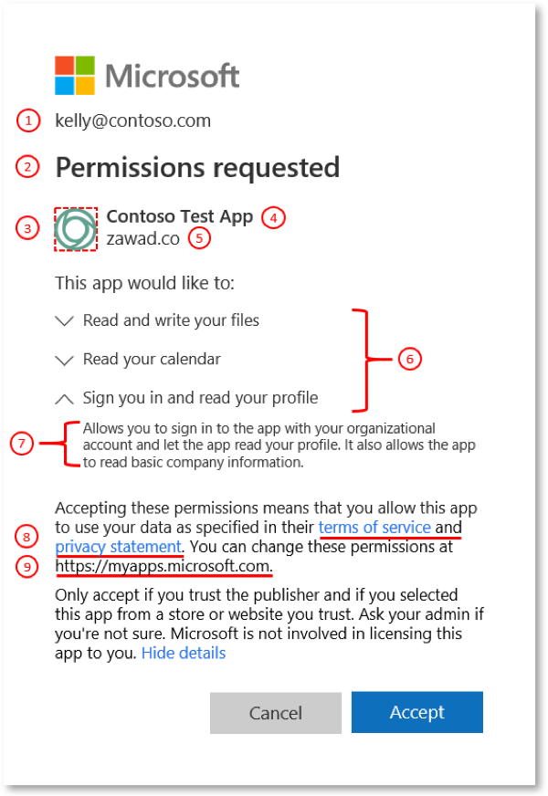
Application consent experiences
User consent flow
when an application developer directs users to the authorization endpoint with the intent to record consent for only the current user.
Admin consent flow
when an application developer directs users to the admin consent endpoint with the intent to record consent for the entire tenant. To ensure the admin consent flow works properly, application developers must list all permissions in the RequiredResourceAccess property in the application manifest.
Notes:
Components of the consent prompt:
1
User identifier
This identifier represents the user that the client application is requesting to access protected resources on behalf of.
2
Title
The title changes based on whether the users are going through the user or admin consent flow. In user consent flow, the title will be “Permissions requested,” while in the admin consent flow the title will have an additional line “Accept for your organization.”
3
App logo
This image should help users have a visual cue of whether this app is the app they intended to access. This image is provided by application developers, and the ownership of this image isn't validated.
4
App name
This value should inform users which application is requesting access to their data. Note that this name is provided by the developers and the ownership of this app name isn't validated.
5
Publisher domain
This value should provide users with a domain they may be able to evaluate for trustworthiness. This domain is provided by the developers, and the ownership of this publisher domain is validated.
6
Permissions
This list contains the permissions being requested by the client application. Users should always evaluate the types of permissions being requested to understand what data the client application will be authorized to access on their behalf if they accept. As an application developer, it is best to request access to the permissions with the least privilege.
7
Permission description
This value is provided by the service exposing the permissions. To see the permission descriptions, you must toggle the chevron next to the permission.
8
App terms
These terms contain links to the terms of service and privacy statement of the application. The publisher is responsible for outlining their rules in their terms of service. Additionally, the publisher is responsible for disclosing the way they use and share user data in their privacy statement. If the publisher doesn't provide links to these values for multi-tenant applications, there will be a bold warning on the consent prompt.
9
https://myapps.microsoft.com
This is the link where users can review and remove any non-Microsoft applications that currently have access to their data.

Slide 11
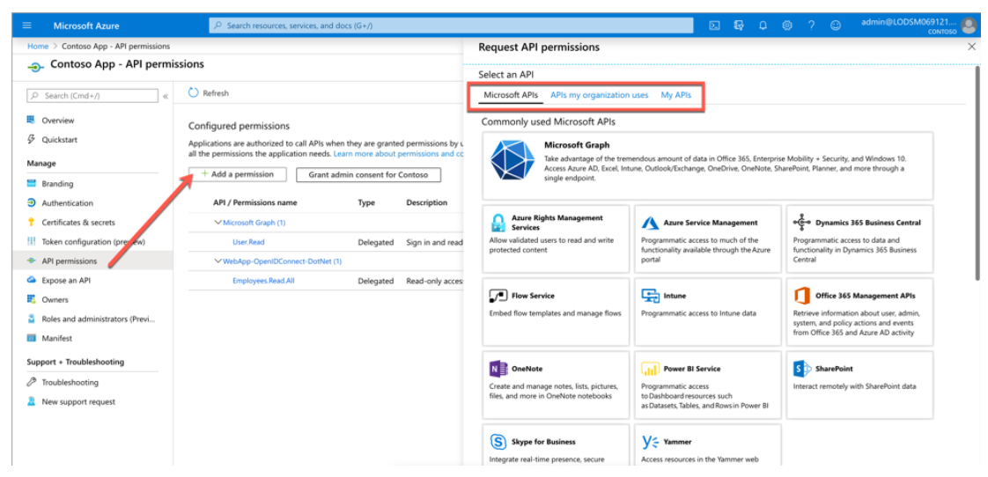
Add permissions to access Web APIs
Microsoft APIs
APIs my organization uses
My APIs

Slide 12
Secure custom APIs with Microsoft identity
Securing a web API with Microsoft identity that can be called by other applications involves two main tasks:
Register & configure an Azure AD application
Define scopes
Code the web API project, configured to support Microsoft identity
Add support to validate the current request has the necessary scopes
Notes:
https://docs.microsoft.com/en-us/learn/modules/identity-secure-custom-api/2-secure-api-microsoft-identity
Many solutions involve creating web APIs to expose functionality to different clients and consumers. Developers can secure these APIs using Microsoft identity to ensure only approved apps can access the web APIs provided they've been granted the necessary permissions.
Once an API has been secured with Microsoft identity, you can enable users and apps to authenticate and access the web APIs though many different types of applications including desktop, mobile, web, and services or daemons. The Microsoft identity platform is a great solution for securing APIs especially when your users and their data are secured with Microsoft identity.
For example, consider the scenario where a company in Office 365 sells categories of products to their customers. Your inventory management system needs to allow certain employees read-only access to products while others can create, edit, and discontinue products. The inventory management system can be developed to leverage multiple APIs, from custom APIs to manage the product inventory to Microsoft Graph to look up different employees.

Slide 13
Call the Microsoft Graph API
The Microsoft Graph API provides programmatic access to Azure AD through REST API endpoints. Applications can use the Microsoft Graph API to perform create, read, update, and delete (CRUD) operations on directory data and objects.
Provides the following features:
REST API endpoints.
Authentication with Azure AD.
Role-based authorization (RBAC).
Differential query.
Directory extensions.
Secured by permission scopes
Enables application scenarios, such as:
Line-of-business (single tenant) application.
Software-as-a-service (multi-tenant) application.
Notes:
Explain Call Microsoft API.
Review the Azure Active Directory Graph API to become comfortable with the Azure AD Graph API quickstart guide, or view the interactive Azure AD Graph API reference documentation.

Slide 14
Demo
Implementing authorization to consume an API
Notes:
Demo Resources Found Here: https://microsoft.sharepoint.com/:w:/t/MOCtoBaselineevents/EUuh8--P6QhCo5oAFmHoa6wBKK-0Kv3xv1oUuZ8C-2a-jg?e=BCThlK

